Slide 1
0510-6201 – Digital Signal Processing Final Project
WNNVD – Weighted Nuclear Norm for Video Denoising
Roy Hachnochi , Uri kapustin

Slide 2
Table of Contents
Mathematical background
Chosen paper & Our project
Literature review of related work
WNNVD
Results & Conclusion
Future work

Slide 3
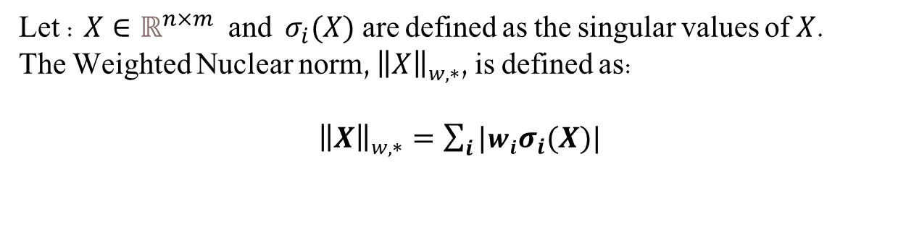
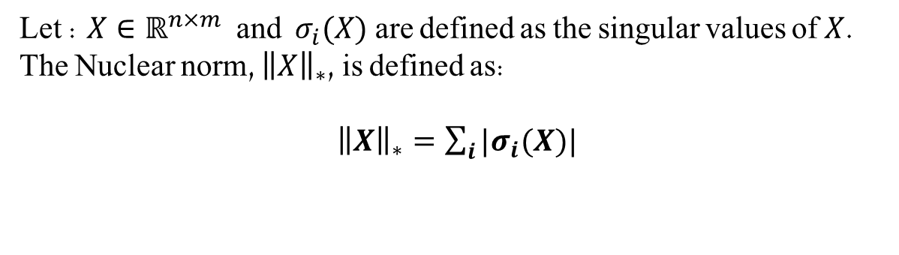
Nuclear Norm (NN)
Let : $X∈ℝ^{n×m}$ and $σ_{i}(X)$ are defined as the singular values of $X$.
The Nuclear norm, ${\left\|X\right\|}_{∗}$, is defined as:
${\left\|X\right\|}_{∗}=\sum_{i}{|σ_{i}(X)|}$
Weighted Nuclear Norm (WNN)
Let : $X∈ℝ^{n×m}$ and $σ_{i}(X)$ are defined as the singular values of $X$.
The Weighted Nuclear norm, ${\left\|X\right\|}_{w,∗}$, is defined as:
${\left\|X\right\|}_{w,∗}=\sum_{i}{|w_{i}σ_{i}(X)|}$

Slide 4
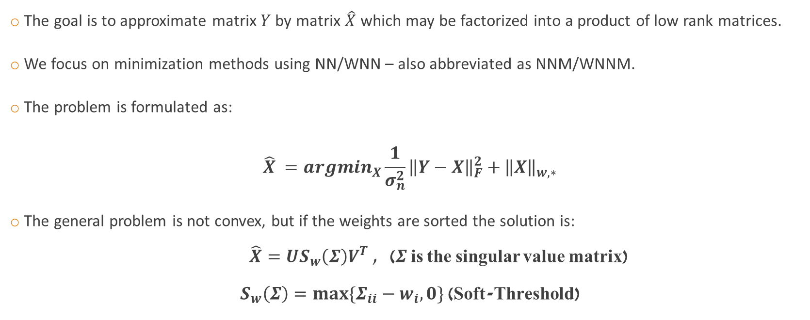
Low-Rank Matrix Approximation (LRMA)
The goal is to approximate matrix $Y$ by matrix $\hat{X}$ which may be factorized into a product of low rank matrices.
We focus on minimization methods using NN/WNN – also abbreviated as NNM/WNNM.
The problem is formulated as:
$$\hat{X} =argmin_{X}\frac{1}{σ_{n}^{2}}{\left\|Y−X\right\|}_{F}^{2}+{\left\|X\right\|}_{w,∗}$$
The general problem is not convex, but if the weights are sorted the solution is:
$\hat{X}=US_{w}\left(Σ\right)V^{T}$ , ($Σ$ is the singular value matrix)
$S_{w}\left(Σ\right)=max⁡\{Σ_{ii}−w_{i},0\}$ (Soft-Threshold)

Slide 5
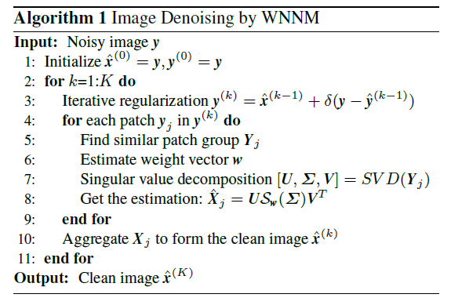
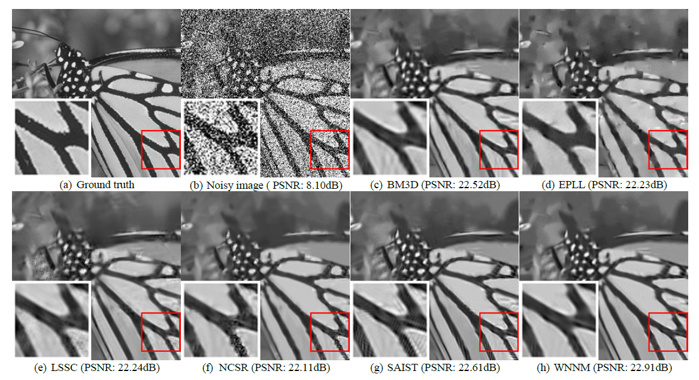
Chosen Paper
“Weighted Nuclear Norm Minimization with Application to Image Denoising” [Gu et. al.]
Utilized the WNNM for image denoising by taking advantage of non-local self similarities.

Slide 6

Chosen Paper
TODO: add a diagram explaining each term of the equation
$\hat{X} =argmin_{X}\frac{1}{σ_{n}^{2}}{\left\|Y−X\right\|}_{F}^{2}+{\left\|X\right\|}_{w,∗}$

Slide 7
Our Project
Weighted Nuclear Norm Minimization for Video Denoising (WNNVD).
The naive solution: Apply WWNID separately per frame.
Main Challenges:
Utilize temporal data (which is not used by the WNNID).
Integrate ideas and solutions from different papers.
Out of Scope:
Processing RGB images.
Non-Causal algorithm.

Slide 8
Literature Review – key papers
“A singular value thresholding algorithm for matrix completion” - Presented the NNM as a convex relaxation for the low-rank minimization problem.
“Image Denoising by Sparse 3-D Transform-Domain” (BM3D) - Was SOTA algorithm and used as comparison. Also, this paper uses the same grouping method as WNNID – block matching (BM).
“Video Denoising by Sparse 3D Transform-Domain Collaborative Filtering” – Proposed a grouping method which creates blocks from videos, utilizing temporal data. Our Block Matching is based on this method.
"Video Denoising, Deblocking, and Enhancement Through Separable 4-D Nonlocal Spatiotemporal Transforms“ (VBM4D) – Proposed a different grouping method. First creating temporal trajectories of patches and then search for similar trajectories. This is an addition to our project that we implemented.

Slide 9
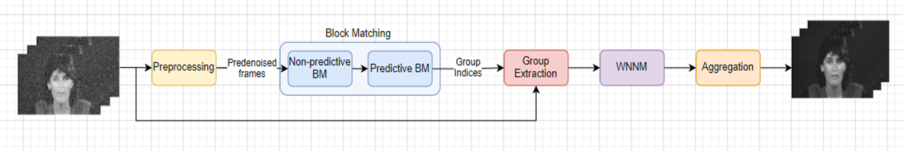
WNNVD – General Description
Algorithm block diagram:
The grouping step (“Block Matching”) has the most complicated, and most important logic.

Slide 10
WNNVD – Preprocessing
A simple and naïve video denoising, e.g Gaussian filter and Median filter.
The purpose of this step is to enhance the performance of the following block matching.

Slide 11
WNNVD – Block Matching
The grouping step. Each group will consist of similar patches both spatially and temporally.
Grouping from different frames is done sequentially.
A list of reference patches is chosen from a single frame
In our case we choose them by grid
“Past” and “Future” frames handled separately.
Done in 2 steps:
Non-Predictive Search –
Executed only in the current reference frame.
Predictive Search –
Executed on the “past” and “future” frames.
Around each similar patch from the previous frame, we open a search window to find a defined number of similar patches.

Slide 12
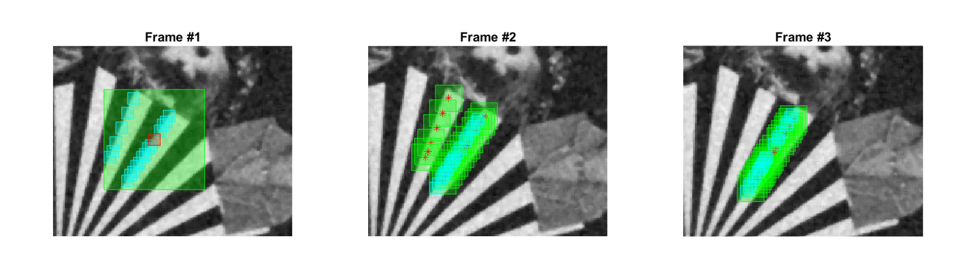
WNNVD – Block Matching (Example)
Red – Reference patch.
Green – Search windows.
Cyan – Matched patches.

Slide 13
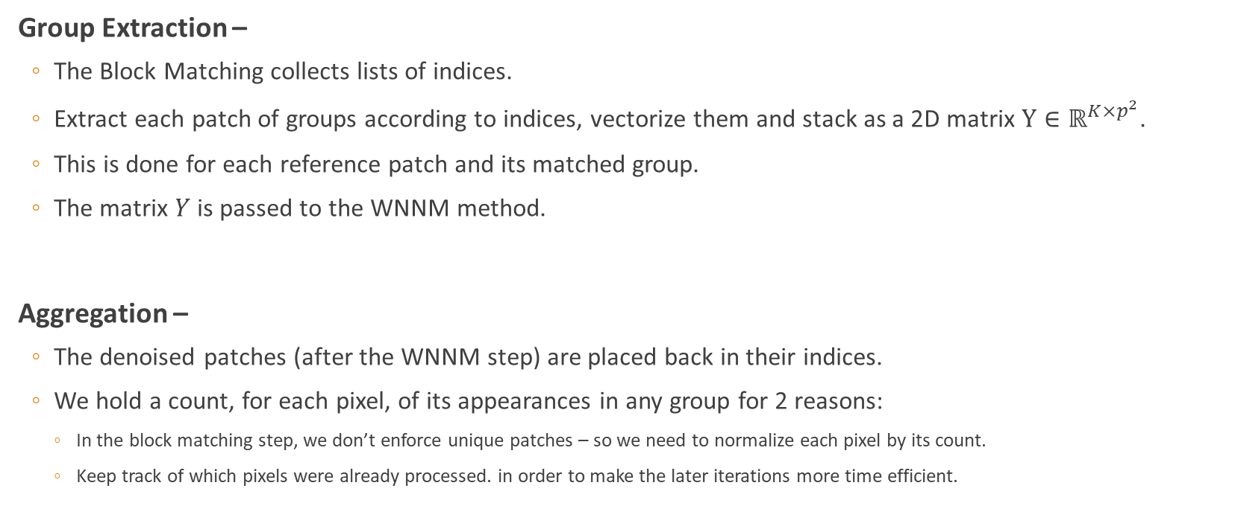
WNNVD – Group Extraction, Aggregation
Group Extraction –
The Block Matching collects lists of indices.
Extract each patch of groups according to indices, vectorize them and stack as a 2D matrix $Y∈ℝ^{K×p^{2}}$.
This is done for each reference patch and its matched group.
The matrix $Y$ is passed to the WNNM method.
Aggregation –
The denoised patches (after the WNNM step) are placed back in their indices.
We hold a count, for each pixel, of its appearances in any group for 2 reasons:
In the block matching step, we don’t enforce unique patches – so we need to normalize each pixel by its count.
Keep track of which pixels were already processed. in order to make the later iterations more time efficient.

Slide 14
WNNVD –WNNM
The denoising step. Based on the mathematical concepts that were presented.
Executed similarly to our reference paper - On 2D matrices.
Each matrix represents a matched group, where each column is a vectorized patch.

Slide 15

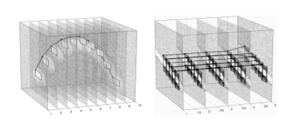
WNNVD – Extension
We attempted to emphasize the temporal data because of its importance.
As explained in VBM4D, SOTA paper for video denoising.
The main modification is the “Block Matching” block –
Instead of grouping patches, we group “trajectories”.
Trajectory consists of sequence of patches from sequential frames, one from each frame.
Each trajectory is created by harnessing the existing predictive and non-predictive search, more sophisticated ways were considered but would exceed the scope of the project.

Slide 16
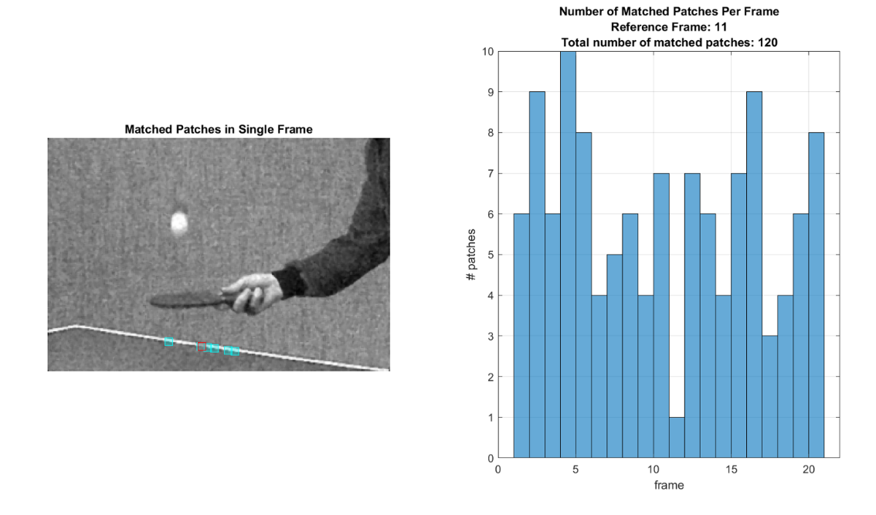
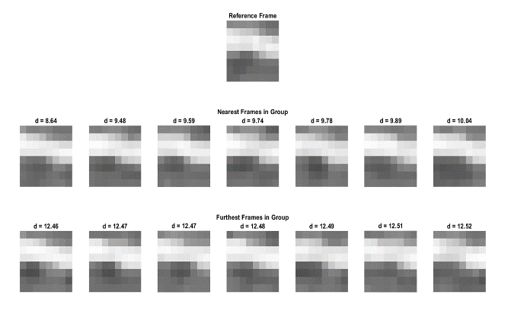
Results – Block Matching

Slide 17
Results – Parameter Analysis

Slide 18
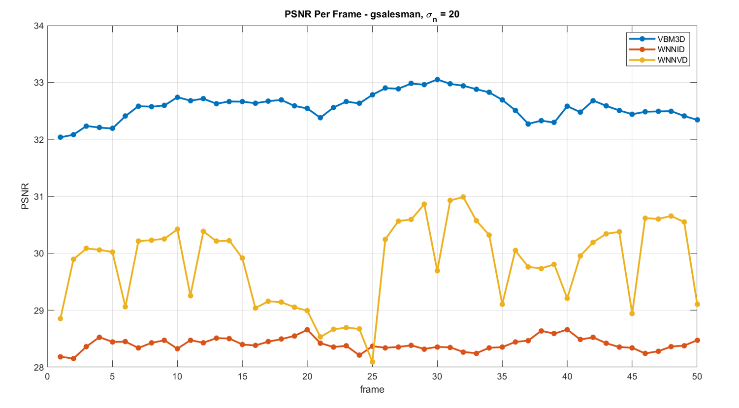
Results - Comparison

Slide 19
Results - Comparison
Noise STD | Video | Algorithm | PSNR | SSIM | Time per frame [sec]
10 | gbicycle | VBM3D | 36.5 | 0.97 | 1.12
 |  | WNNID | 34.2 | 0.97 | 73.35
 |  | WNNVD | 36.1 | 0.97 | 62.92
 | gflower | VBM3D | 29.8 | 0.95 | 0.19
 |  | WNNID | 27.7 | 0.93 | 11.23
 |  | WNNVD | 28.8 | 0.94 | 12.03
 | gmissa | VBM3D | 39.3 | 0.93 | 0.26
 |  | WNNID | 37.8 | 0.92 | 21.12
 |  | WNNVD | 38.2 | 0.92 | 16.23
 | gsalesman | VBM3D | 36.4 | 0.95 | 0.24
 |  | WNNID | 32.9 | 0.91 | 19.24
 |  | WNNVD | 34.2 | 0.92 | 10.18
 | gstennis | VBM3D | 31.8 | 0.87 | 0.21
 |  | WNNID | 29.6 | 0.83 | 16.55
 |  | WNNVD | 29.2 | 0.77 | 12.92
 | lena | WNNVD | 35.3 | 0.91 | 49.81
Noise STD | Video | Algorithm | PSNR | SSIM | Time per frame [sec]
20 | gbicycle | VBM3D | 33.6 | 0.95 | 1.13
 |  | WNNID | 29 | 0.92 | 72.36
 |  | WNNVD | 32.6 | 0.95 | 63.79
 | gflower | VBM3D | 27.5 | 0.91 | 0.19
 |  | WNNID | 23.7 | 0.85 | 11.01
 |  | WNNVD | 26 | 0.85 | 14.79
 | gmissa | VBM3D | 37.5 | 0.91 | 0.26
 |  | WNNID | 34.1 | 0.88 | 20.52
 |  | WNNVD | 35.5 | 0.9 | 17.37
 | gsalesman | VBM3D | 33.6 | 0.91 | 0.25
 |  | WNNID | 28.8 | 0.81 | 19.12
 |  | WNNVD | 30.1 | 0.82 | 11.78
 | gstennis | VBM3D | 29.6 | 0.77 | 0.21
 |  | WNNID | 26.8 | 0.67 | 16.39
 |  | WNNVD | 26.3 | 0.53 | 15.27
 | lena | WNNVD | 32.2 | 0.87 | 49.64
Noise STD | Video | Algorithm | PSNR | SSIM | Time per frame [sec]
30 | gbicycle | VBM3D | 31.1 | 0.93 | 1.13
 |  | WNNID | 26.5 | 0.9 | 71.66
 |  | WNNVD | 29.4 | 0.9 | 65.86
 | gflower | VBM3D | 25.4 | 0.86 | 0.19
 |  | WNNID | 21.2 | 0.78 | 11.07
 |  | WNNVD | 22.6 | 0.74 | 15.64
 | gmissa | VBM3D | 35.6 | 0.91 | 0.26
 |  | WNNID | 32.6 | 0.88 | 20.47
 |  | WNNVD | 33.3 | 0.88 | 18.24
 | gsalesman | VBM3D | 30.9 | 0.85 | 0.25
 |  | WNNID | 26.7 | 0.73 | 19.03
 |  | WNNVD | 27.3 | 0.72 | 13.27
 | gstennis | VBM3D | 27.7 | 0.66 | 0.21
 |  | WNNID | 25.3 | 0.57 | 16.22
 |  | WNNVD | 25.6 | 0.5 | 17.47
 | lena | WNNVD | 30.2 | 0.84 | 48.98

Slide 20
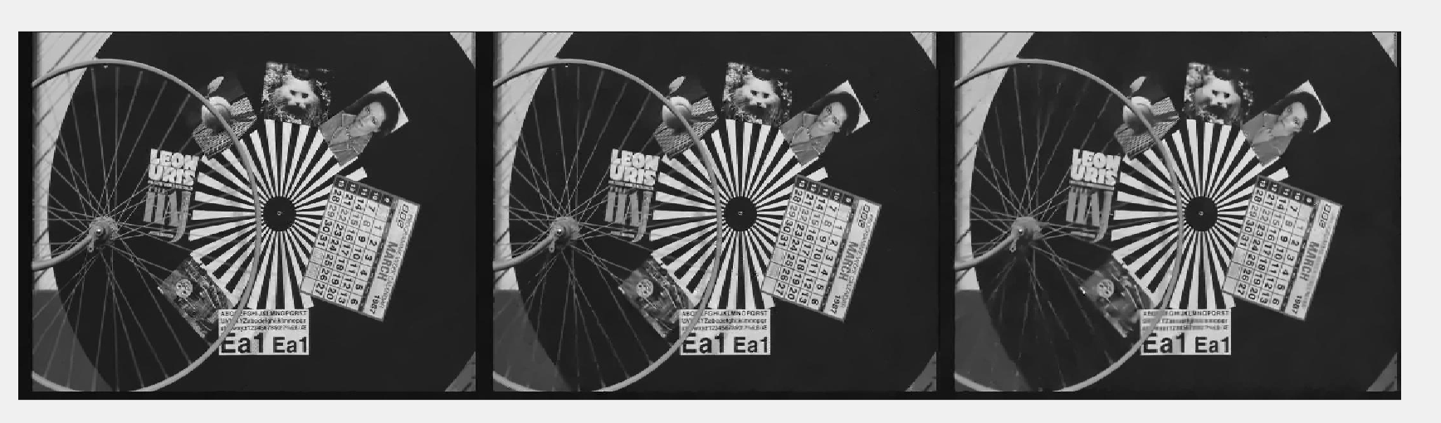
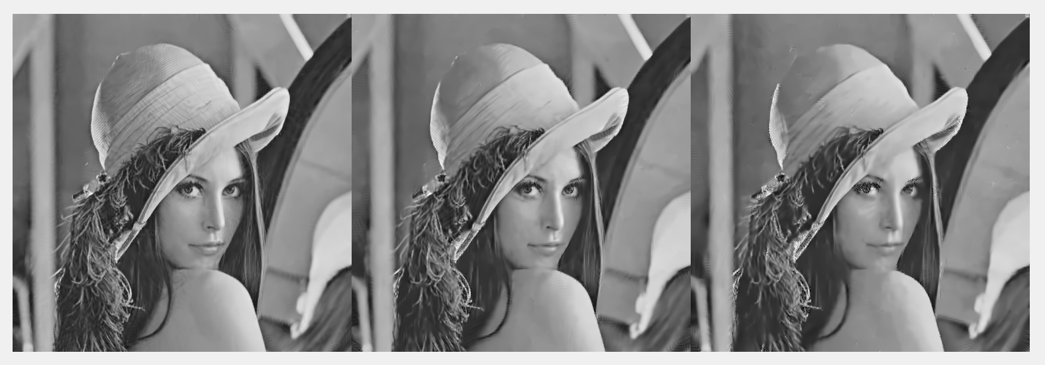
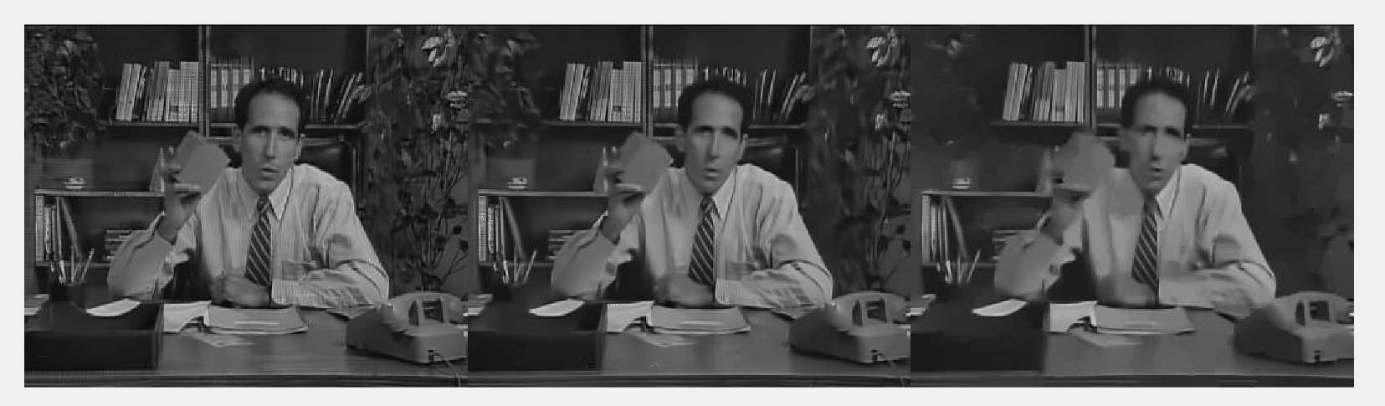
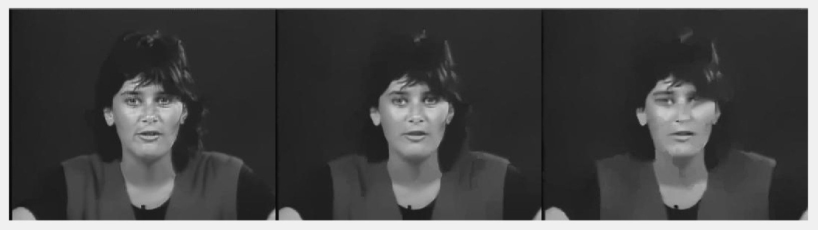
Results - Examples

Slide 21
Suggested Future Work
Parameter optimization.
Instead of vectorizing blocks, work with 3-D/4-D blocks and implement High-Order SVD.
Modify the algorithm for online video denoising (causal denoising).
Expand the algorithm to support RGB images/videos.
Optimize run-time.

Slide 22
Summary
The core signal-processing concept we studied is LRMA utilization for image and video denoising.
Specifically, NNM/WNNM relaxation methods.
We explored different ways of grouping methods (BM, TM).
We conducted analysis and research of our proposed algorithm.
We compared our results to SOTA papers in the classical regime of video and image denoising.

